Slide 1
S PARAMETERS OF BAND PASS FILTER USING ADS
Batch – 02
171FA05305
171FA05329
171FA05362

Slide 2
OBJECTIVE:
To design and find the scattering parameters of the BAND PASS FILTER using ADVANCED DESIGN SYSTEM(ADS) SOFTWARE in the frequency range of 2.4Ghz to 2.6Ghz

Slide 3
INTRODUCTION TO ADS SOFTWARE:
Advanced Design System (ADS) is an electronic design automation software system produced by Keysight EEsof EDA,a division of Keysight Technologies.
It provides an integrated design environment to designers of RF electronic products such as mobile phones, pagers, wireless networks, satellite communications, radar systems, and high-speed data links.

Slide 4
BANDPASS FILTER: It is an electronic device or circuit that allows signals between two specific frequencies to pass, but that discriminates against signals at other frequencies.
SCATTERING PARAMETERS: For a two-port device there are four S parameters S11, S21, S12, and S22. S11 and S22 are simply the forward and reverse reflection coefficients, with the opposite port terminated in Z0

Slide 5
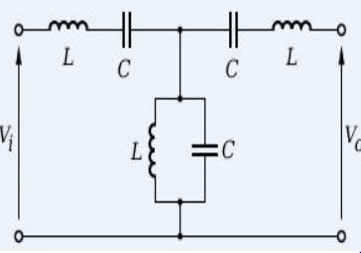
Circuit diagram:

Slide 6
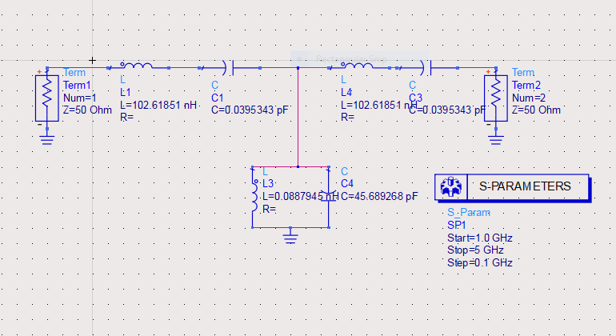
Schematic diagram:

Slide 7
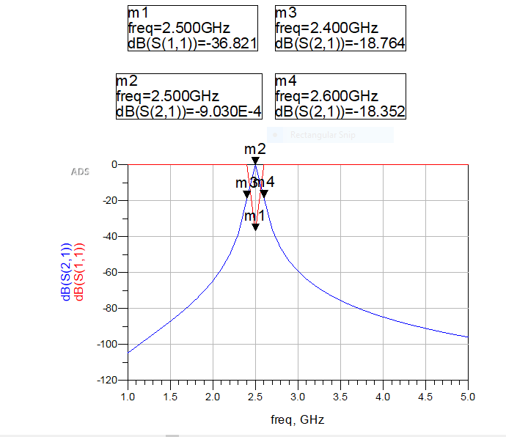
Plotted cell:

Slide 8
ADVANTAGES:
Small in size and excellent electrical performance.
Stability
Low insertion loss and VSWR
DISADVANTAGES:
Narrow bandwidth
Lower gain
Low power handling capacity

Slide 9
APPLICATIONS:
Wireless transmitters and recievers
Widely used in optics such as lasers
Communication systems
Audio signal processing

Slide 10
Thank you

